Slide 1
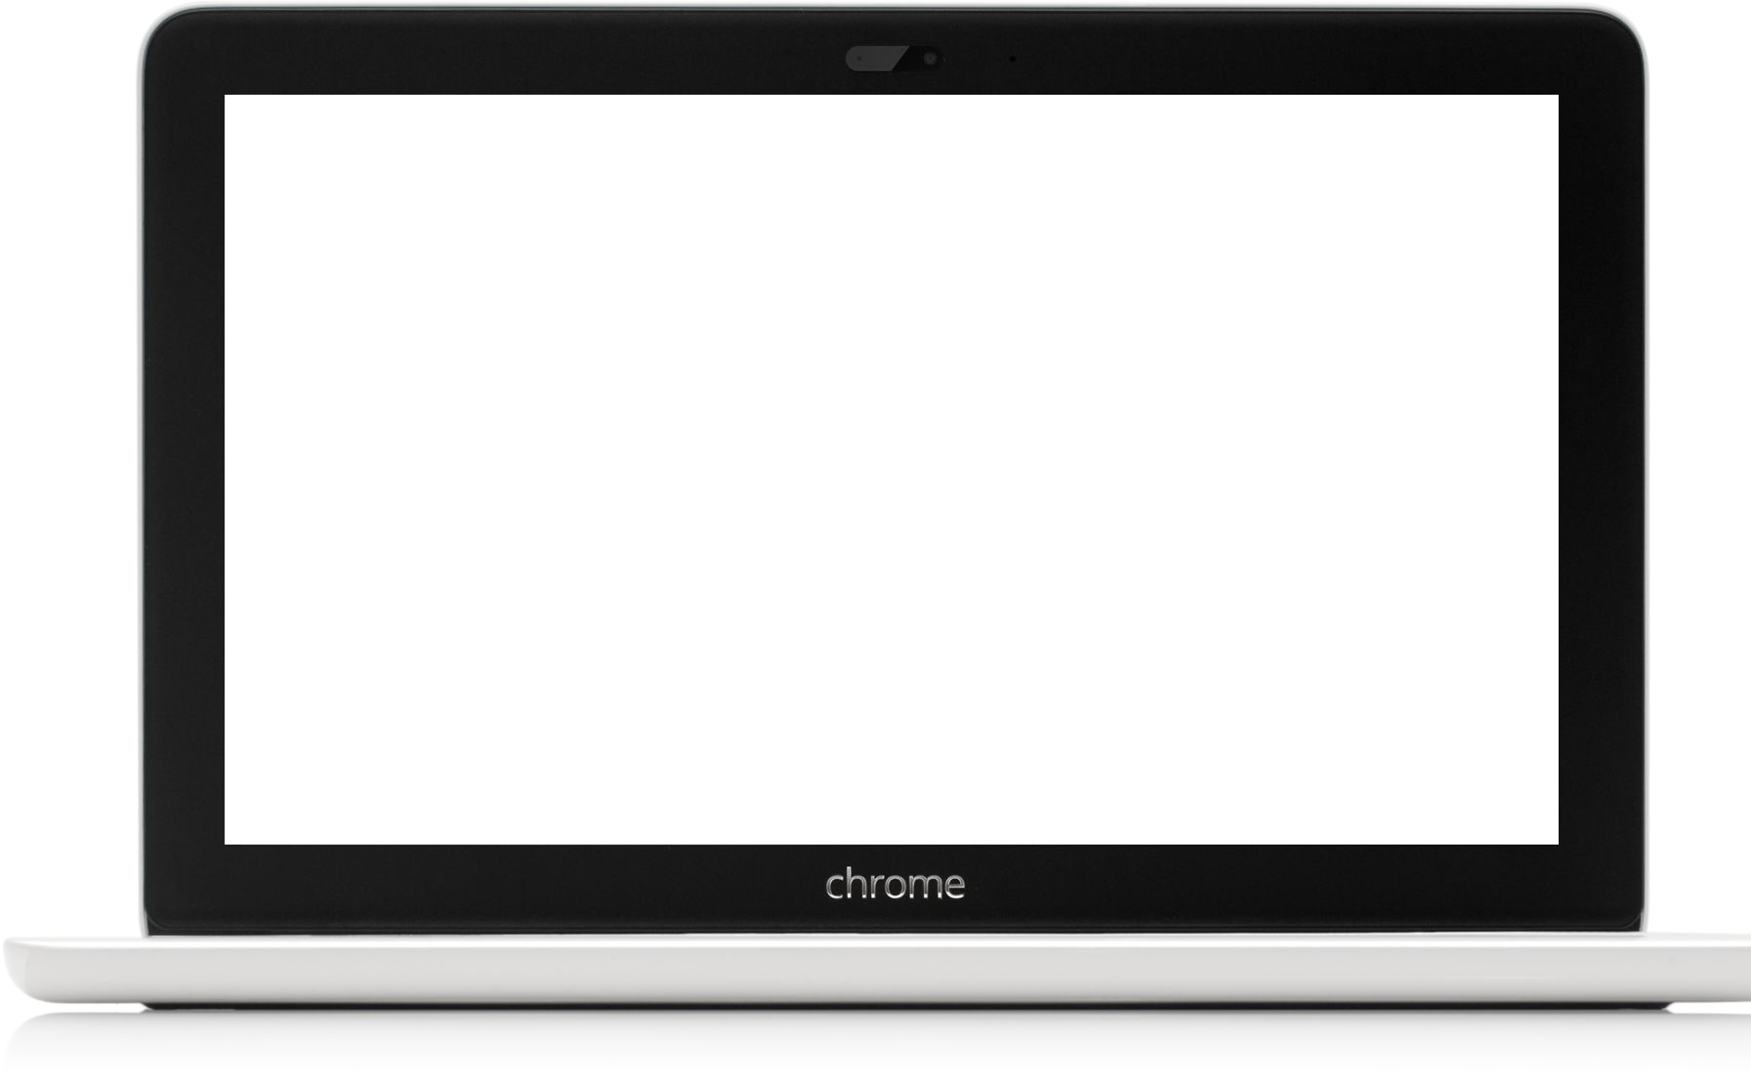
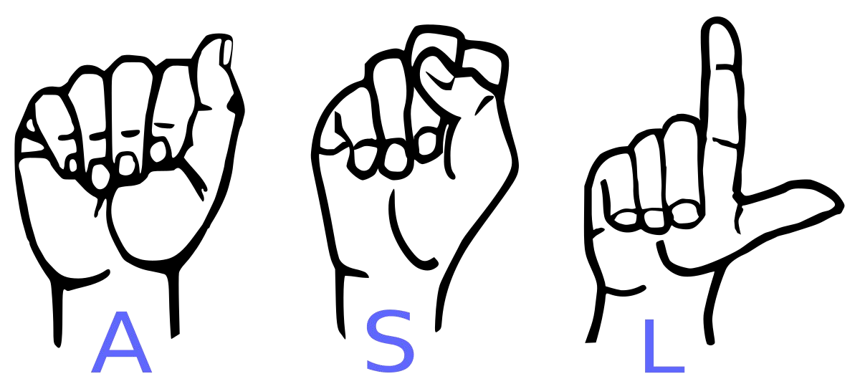
CONVERSION OF SIGN LANGUAGE TO TEXT
ALEN P SHYJU
12312257

Slide 2
ABSTRACT
This project aims to create a computer application and train a model which when shown a real time video of hand gestures of American Sign Language shows the output for that particular sign in text format on the screen.

Slide 3
American sign language is a predominant sign language Since the only disability D&M people have is communication related and they cannot use spoken languages hence the only way for them to communicate is through sign language.
Communication is the process of exchange of thoughts and messages in various ways such as speech, signals, behavior and visuals. Deaf and Mute(Dumb)(D&M) people make use of their hands to express different gestures to express their ideas with other people. Gestures are the nonverbally exchanged messages and these gestures are understood with vision. This nonverbal communication of deaf and dumb people is called sign language.
INTRODUCTION

Slide 4
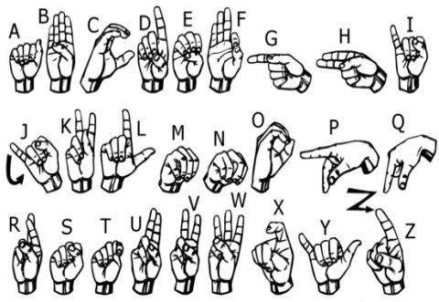
We implemented 27 symbols(A-Z, blank) of ASL in our project

Slide 5
METHODOLOGY
The system utilizes a vision-based approach, where all signs are conveyed using bare hands, thereby eliminating the need for artificial devices for interaction.

Slide 6
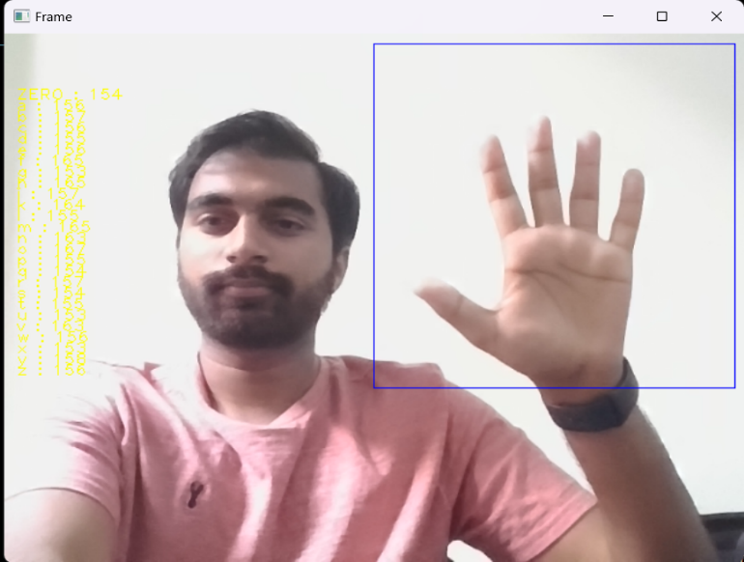
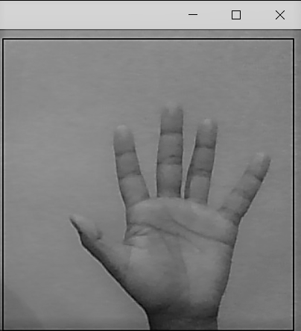
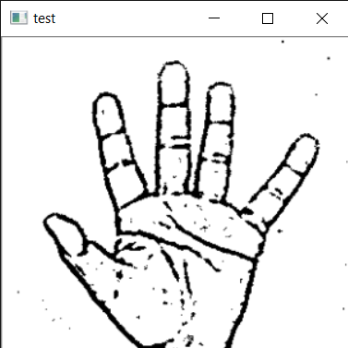
How we generated data set and did Data Preprocessing
Capturing Raw Image
Gray Scale Image
Image Post Gaussian Blur

Slide 7

Why we Created our own Dataset
For the project, I tried to find already made data sets but I couldn’t find dataset in the form of raw images that matched my requirements.
All we could find were the datasets in the form of RGB values.
Hence we decided to create our own data set.

Slide 8
GESTURE CLASSIFICATION
Layer 1
Classify between 27 Symbols
Layer 2
Classify between Similar Symbols

Slide 9

Algorithm Layer 1
Apply gaussian blur filter and threshold to the frame taken with opencv to get the processed image after feature extraction.
This processed image is passed to the CNN model for prediction and if a letter is detected for more than 50 frames then the letter is printed and taken into consideration for forming the word.
Space between the words are considered using the blank symbol.

Slide 10

Algorithm Layer 2:
We detect various sets of symbols which show similar results on getting detected.
We then classify between those sets using classifiers made for those sets only.
In our testing we found that following symbols were not showing properly and were giving other symbols also :
For D
For U
For I
For S
: R and U
: D and R
: T, D, K and I
: M and N

Slide 11
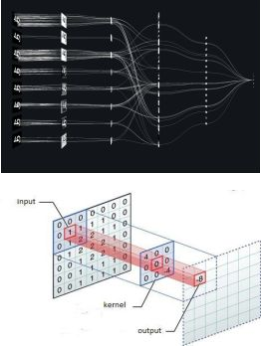
Convolutional Neural Networks
CNNs consist of multiple convolutional layers each layer containing numerous “filters” which perform feature extraction.
Initially these “filters” are random and by training, the feature extraction gets better by better.
It’s primarily used for image classification

Slide 12
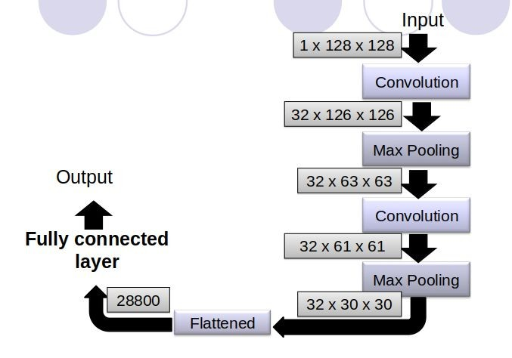
CNN Classifier Model

Slide 13
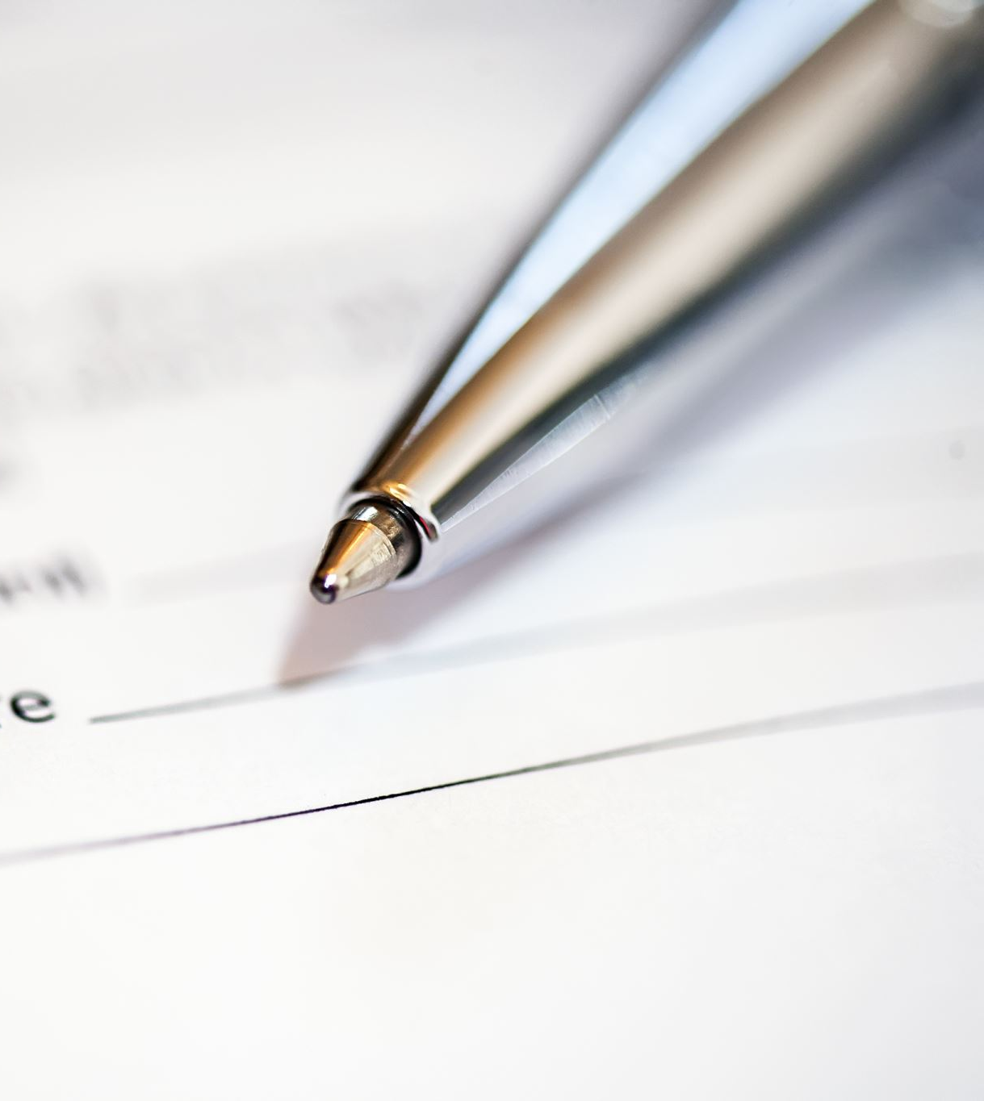
Implementation
Whenever the count of a letter detected exceeds a specific value and no other letter is close to it by a threshold we print the letter and add it to the current string(In our code we kept the value as 50 and difference threshold as 20).
Otherwise we clear the current dictionary which has the count of detections of present symbol to avoid the probability of a wrong letter getting predicted.
Whenever the count of a blank(plain background) detected exceeds a specific value and if the current buffer is empty no spaces are detected.
In other case it predicts the end of word by printing a space and the current gets appended to the sentence below.

Slide 14
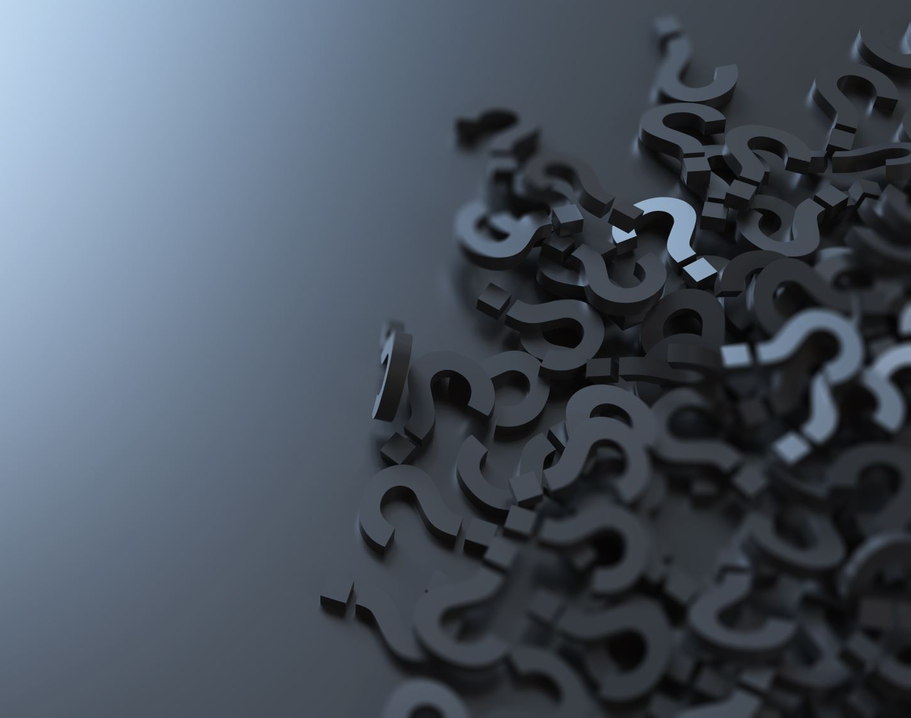
Autocorrect feature
A python library Hunspell_suggest is used to suggest correct alternatives for each (incorrect) input word and we display a set of words matching the current word in which the user can select a word to append it to the current sentence.This helps in reducing mistakes committed in spellings and assists in predicting complex words.

Slide 15
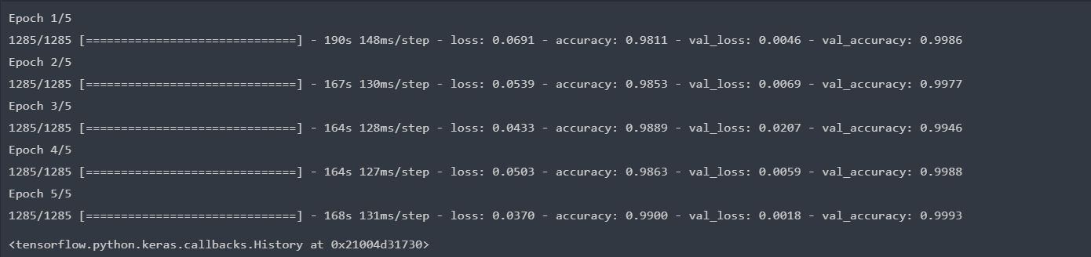
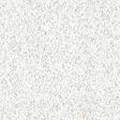
Result
We have achieved a 95.8% accuracy using only layer 1 of our algorithm. When combining layer 1 and layer 2, we achieve an accuracy of 98.0%, surpassing the accuracy of most current research papers on American Sign Language

Slide 16
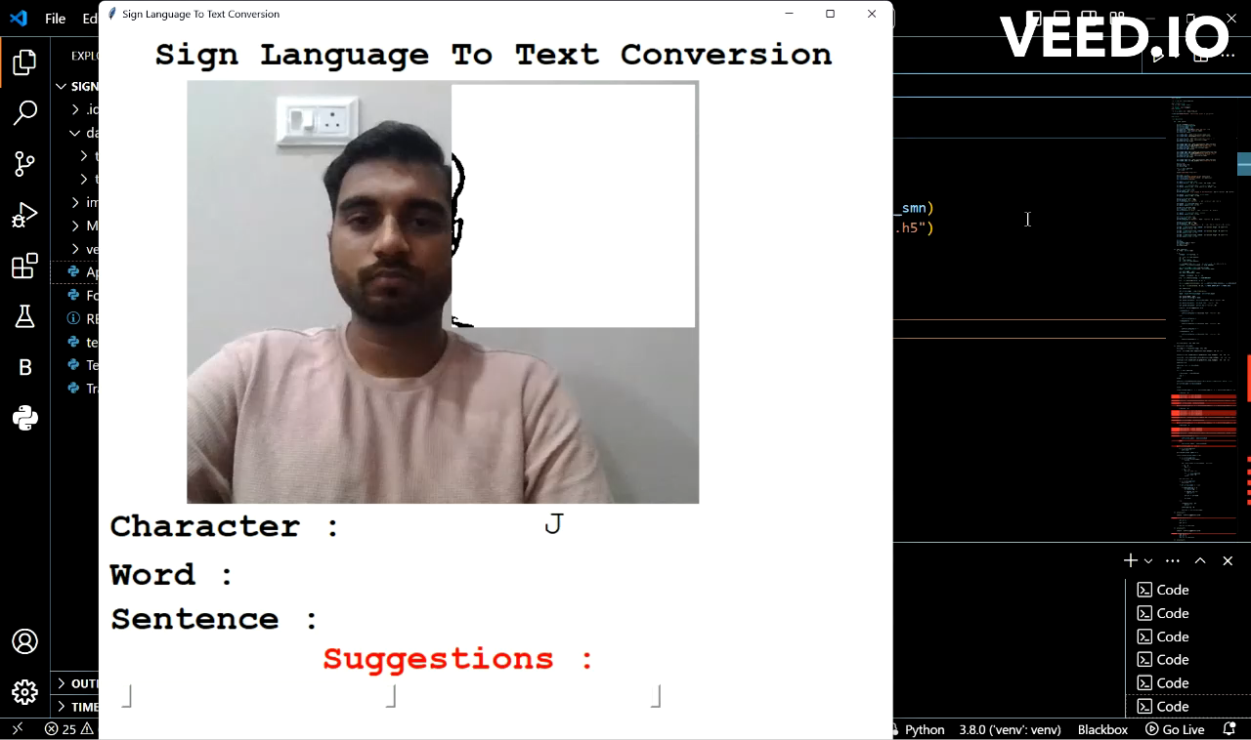
OUTPUT
https://drive.google.com/file/d/1fTa91ptCa0nvTyuxC0A5fXOmEbcK5Hv0/view?usp=sharing
Press play button ->

Slide 17
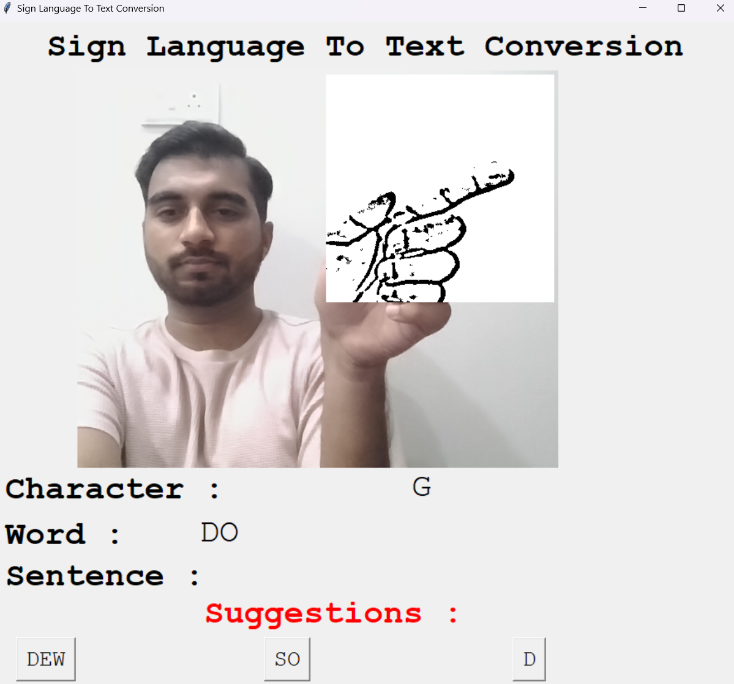
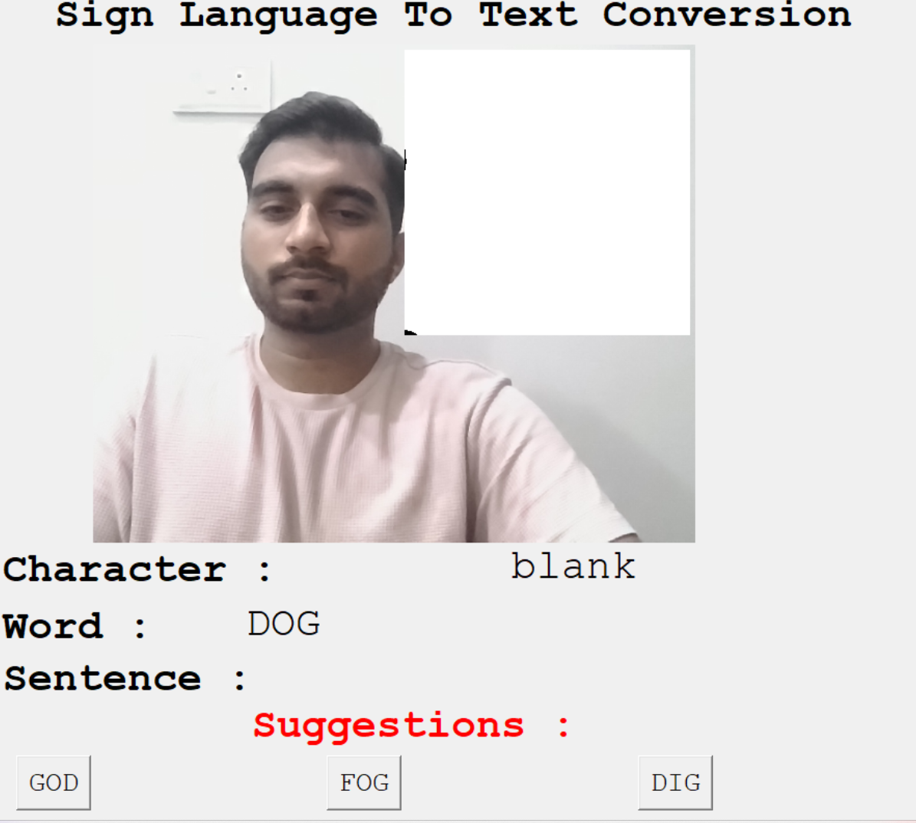
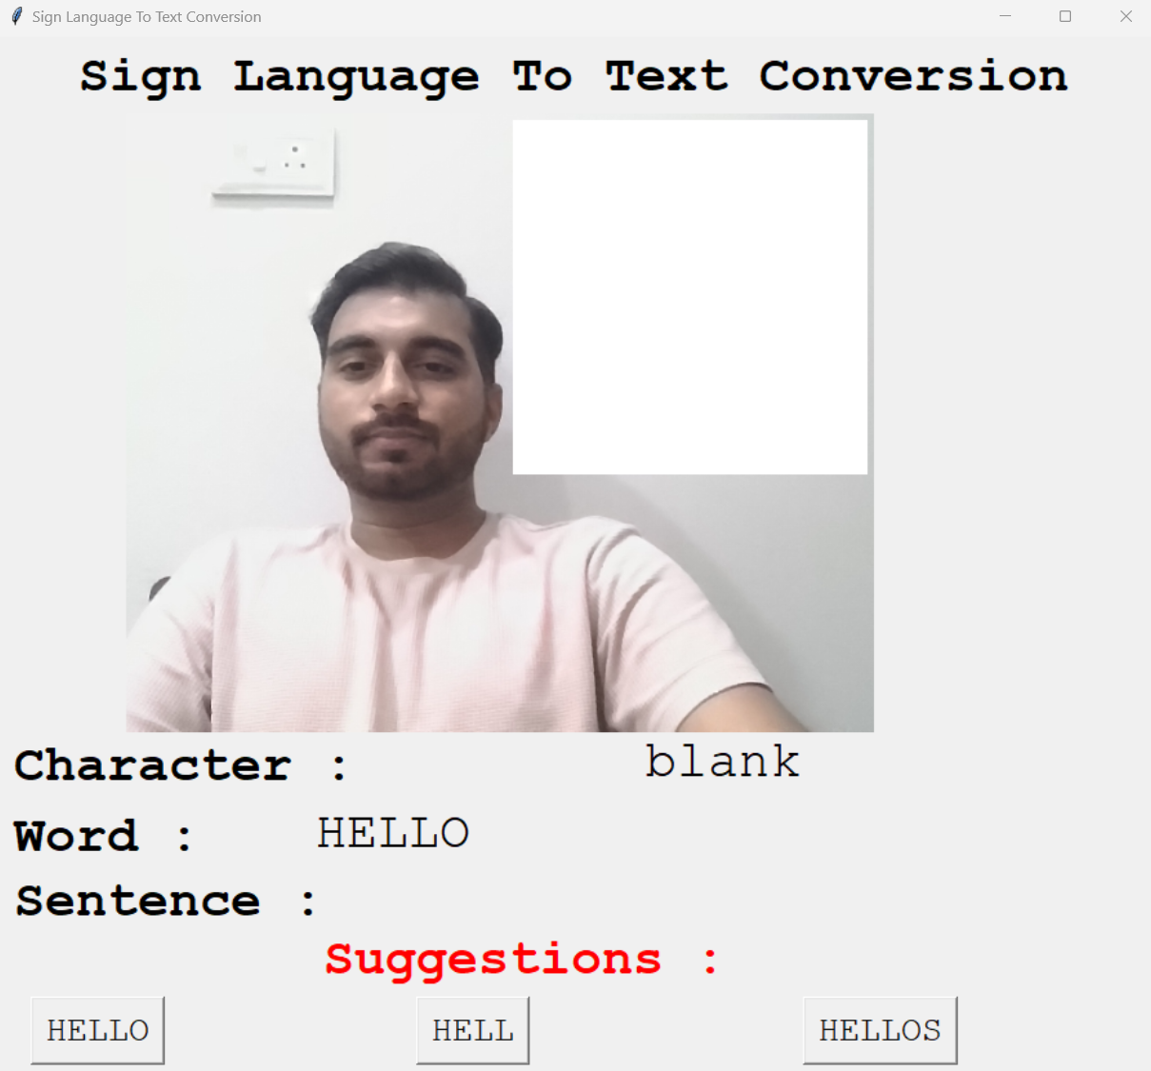
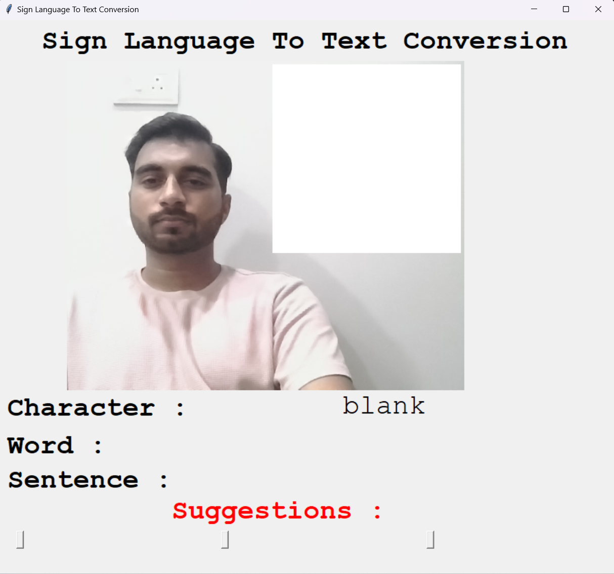

Slide 18
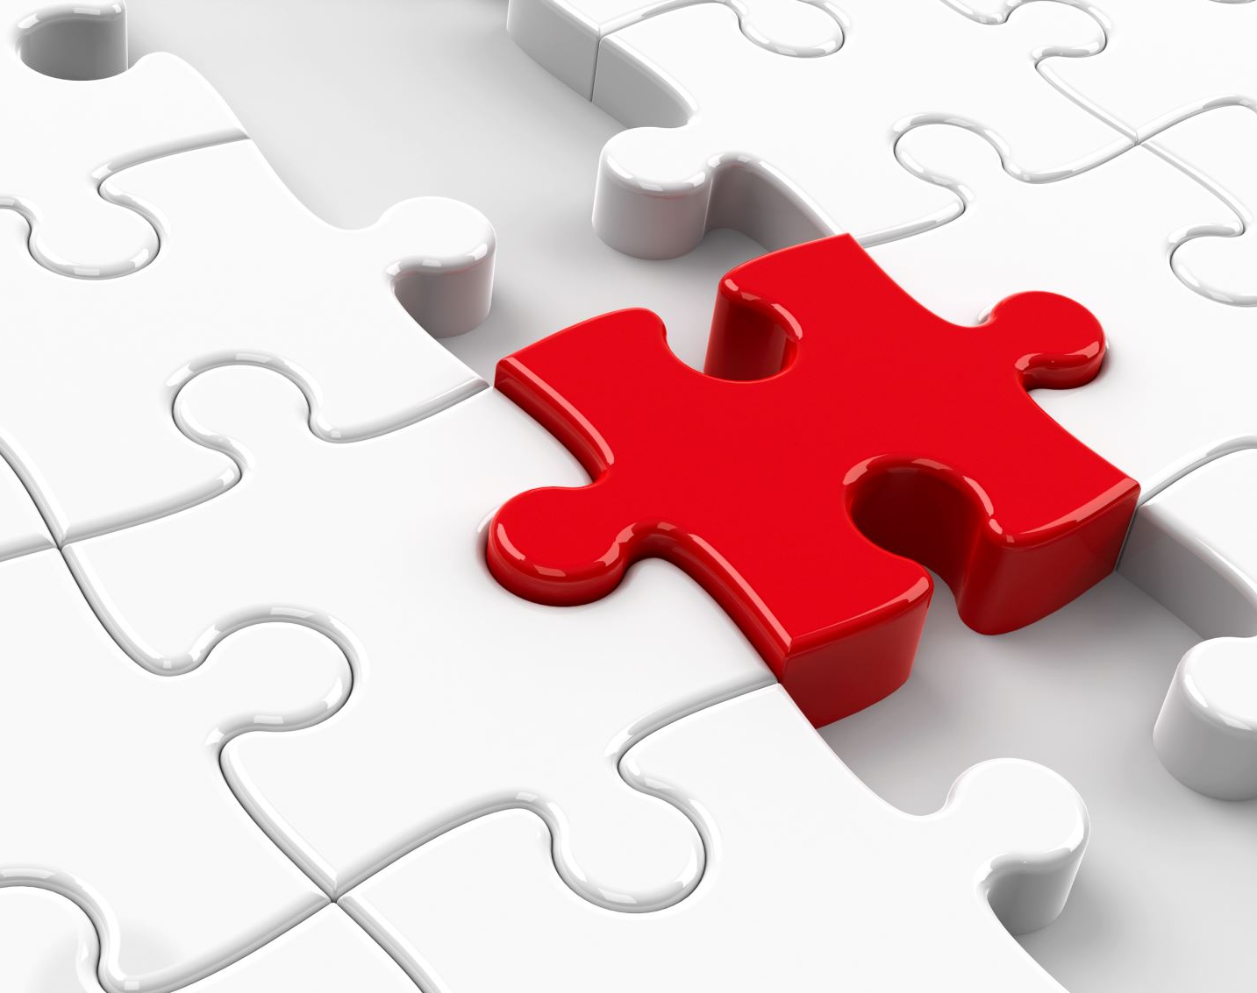
CHALLENGES FACED
I couldn’t find a dataset with raw images of all the asl characters so we made our own dataset
Second issue was to select a filter for feature extraction. i tried various filter including binary threshold, canny edge detection, gaussian blur etc. ,of which gaussian blur filter was giving better results.
Issues were faced relating to the accuracy of the model we trained in earlier phases which we eventually improved by increasing the input image size and also by improving the dataset.

Slide 19
Limitations of model
The model works well only in good lighting conditions.
Plain background is needed for the model to detect with accuracy.

Slide 20

Conclusion
In this report, a functional real time vision based american sign language recognition for D&M people have been developed for asl alphabets.
Achieved an accuracy of 98.00% on dataset.
Prediction has been improved after implementing two layers of algorithms in which we verify and predict symbols which are more similar to each other.

Slide 21

Future Scope
We are planning to achieve higher accuracy even in case of complex backgrounds by trying out various background subtraction algorithms.
We are also thinking of improving the preprocessing to predict gestures in low light conditions with a higher accuracy.

Slide 22

Software Requirements
Python 3.13
Tensorflow 2.16
OpenCV
4.9.0
NumPy 1.26.4
Matplotlib 3.8.4
Hunspell 2.0.2
Keras
3.3.2
PIL
10.3.0

Slide 23
UNDER THE SUPERVISION OF:
Mrs. Navpreet Karu
EFFORT BY
Alen P Shyju
12312257
https://github.com/AlenShyju/-Sign-Languages-To-Text-Using-Finger-Gestures

Slide 24

THANK YOU

